Slide 1

01
Numbers to Narrative:
Building Compelling Data Stories with Tableau
SELMA DOGIC

Slide 2
Why Tableau?
Industry Leader
Community
Transferrable skills
frequent updated and incorporation of cutting edge technology
(autoML, augmented analytics, etc.)
How I Use Tabelau
EDA
Business Reporting
Advanced Analytics
as a decision making tool for my business consumers

Slide 3
Makeover Monday
Today's Setup:
Tableau (Public) application
Data (found on data.world)
everything that we do today you will be able to find on my GitHub

Slide 4

Agenda
01
2023 Week 14 Challenge Intro
02
Review of Current Dashboard
03
Review New Story
04
Distill the Data
05
Tell the Story
Notes:
This will not be a live coding / follow along session
You will have the datasets avaiable, along with the slides and the solutions to the exercises to practice later
I will be doing this in DBeaver, which is a free mutli-platform database tool that I have used at multiple organizations (including Carter's)

Slide 5
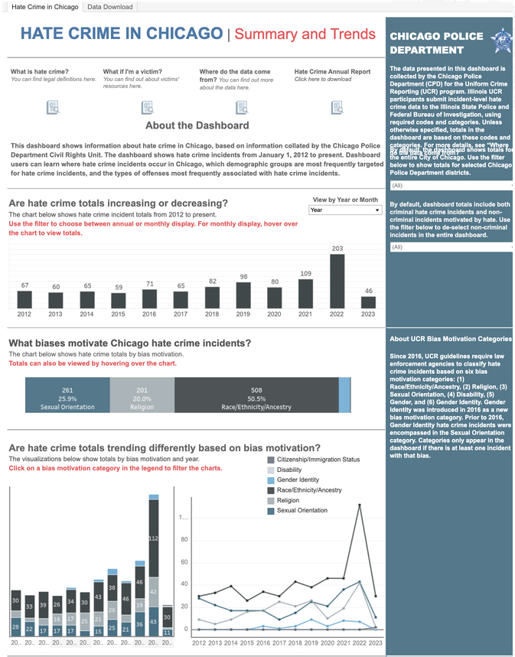
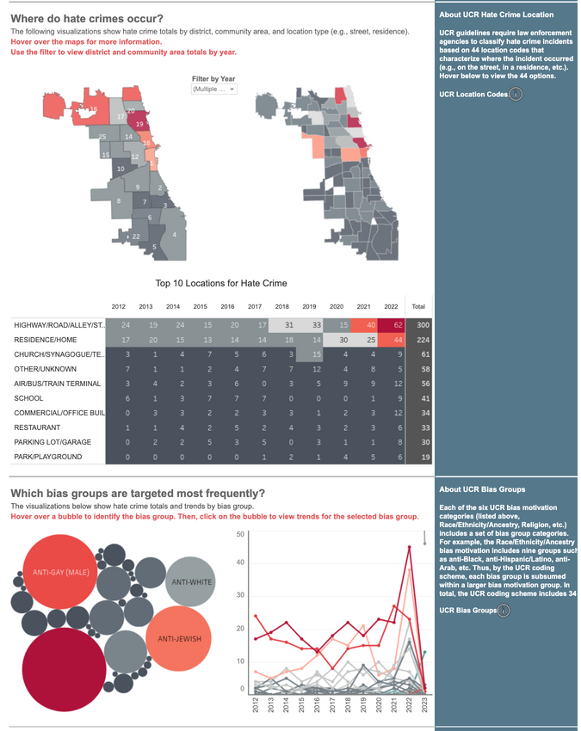
Hate Crime in Chicago
https://home.chicagopolice.org/statistics-data/data-dashboards/hate-crime-dashboard/
First Take?
too long!
What is the story here?
current dashboard is trying to deliver too many
01
Notes:
1. Let's take a peek at the orders table first:
select * from orders limit 5
This will give us a sense of the data in the table and each columns data type
2. Let's look at our first exercise "What was our historical annual profit?"
Let's just start by querying the information we need to derive the answer - i.e. order_date and profit
select order_date, profit from orders
This will give us the same level of granularity as select * but we're excluding columns...we don't want this. We need to aggregate to a level higher..from order level to date.
select order_date, sum(profit) from orders group by order_date
This is close, but we need to group at the year level not date.
select DATE_PART('year', order_date), sum(profit) from orders group by DATE_PART('year', order_date)
or
select extract(year from order_date) yr, sum(profit) from orders group by order_date

Slide 6
New Story
In this first part we'll do some create a sheet and explore the data.
Let's look at:
total number of hate crimes
% change of crimes over time by motivation
Let's first explore the data
Potential insights to explore:
Are crimes on the rise?
is there a difference in trends?
Who is victimized and who is offending?
How are these hate crimes occuring?
Where are they happening the most?
For the sake of time, I'll focus on the first insight
1
CONNECT TO DATA
Open desktop appication and navigate to data connection pane. Select Microsoft Excel
2
CREATE A SHEET
Select New Sheet. Explore the Tableau workspace here.
3
CLEAN UP SOME DATA
Group motivation and disposition
Change date data type
03

Slide 7
New Story
By now, we've developed many sheets from one
Going from sheets to a story
Adding text and color
Let's put it all together
Z-Scan
Key Components of a dashboard:
title
text
interactivity
colors
1
CREATE A DASHBOARD
Click on dashboard icon.
2
ADD SHEETS
Add sheet to the canvas
3
ADD TEXT OBJECTS
Add text objects to navigate users
03

Slide 8
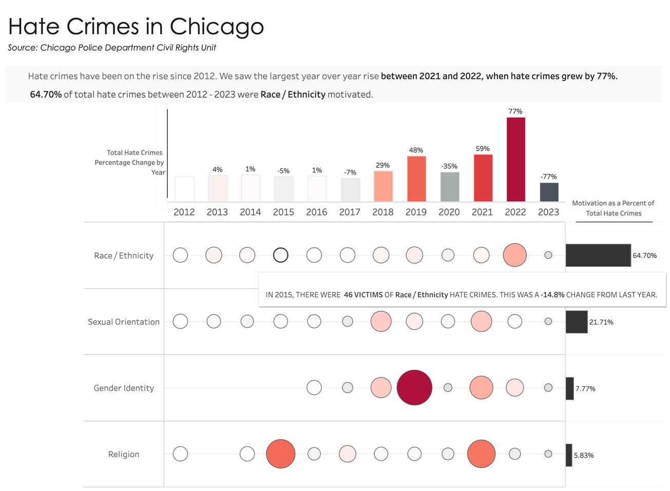
Hate Crime in Chicago
(Selma's Version)
https://home.chicagopolice.org/statistics-data/data-dashboards/hate-crime-dashboard/
Delivered key points via text
Concise design to group similar insights and show trends both over time and by motivation
Text prompts
Additional Information via Tooltip
01

Slide 9
Summary
Engage with learning community. These are great ways to learn and build your portfolio
Makeover Monday
Workout Wednesday
Start small
Distill insights concisely and leverage text/narration to tell your story!
Notes:
Send links to Fatima

Slide 10
Resources
GitHub: https://github.com/selmadogic/storytelling-in-tableau
Visual Vocabulary - best charts based on the insights / relationships your trying to display
Makeover Monday
Workout Wednesday

Slide 11



Thank you
LET'S CONNECT!
linkedin.com/in/selmadogic
@selmadogic

